Slide 1
Balancing Order and Chaos
Lessons Learned from Scaling to 250+
Andrew Barron
Design Director & Product Dev Lead
Bohemia Interactive Simulations

Slide 2
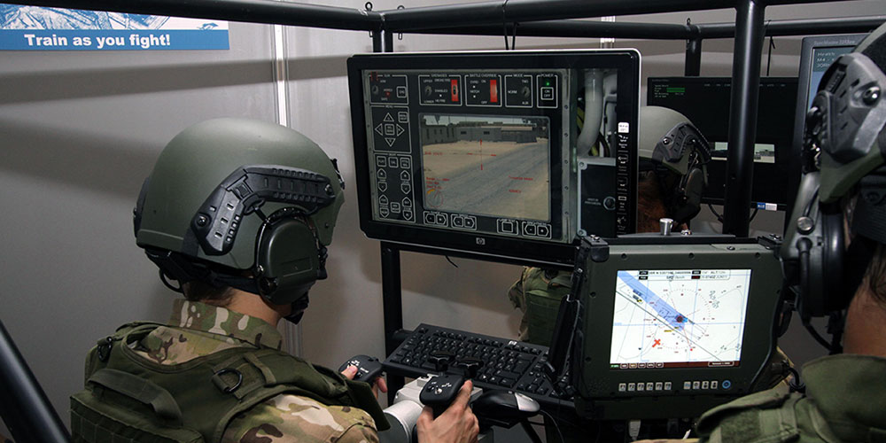

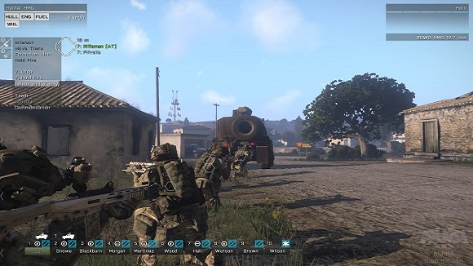


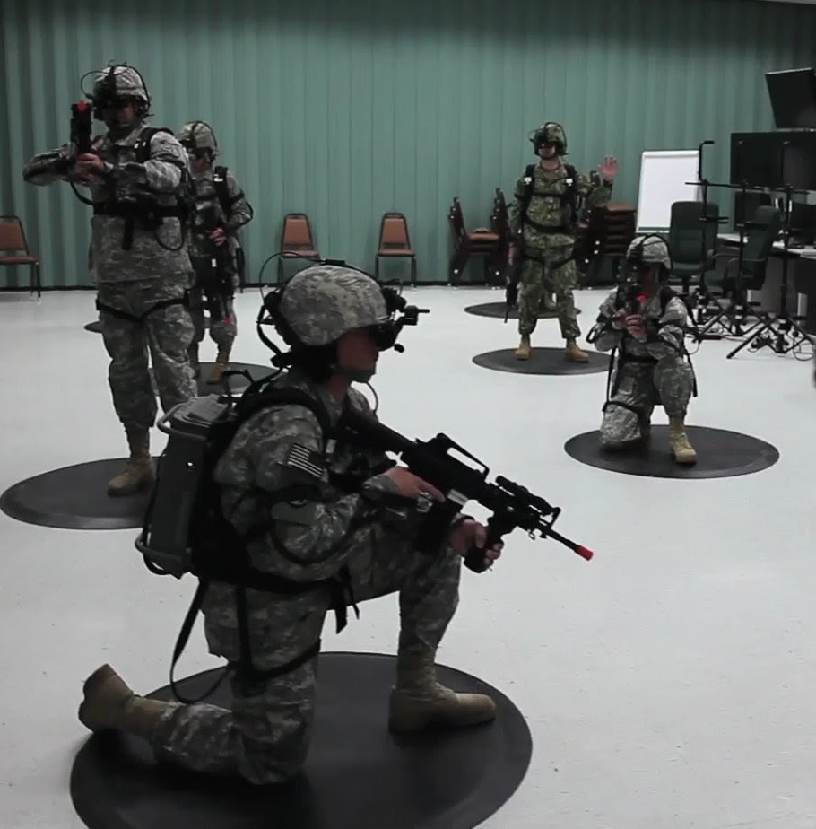



Bohemia Interactive Simulations (BISim)

Slide 3
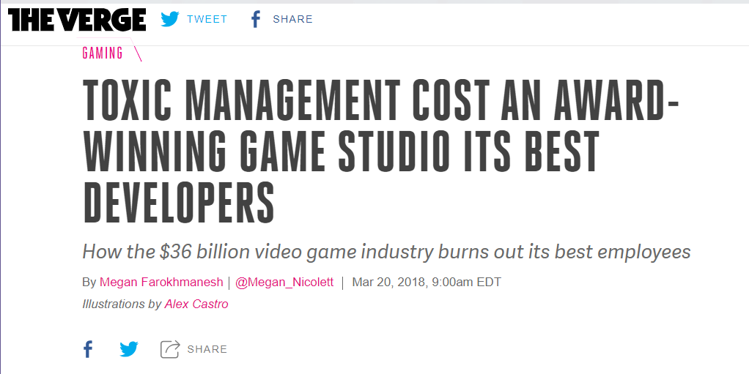
A cautionary tale...
Small team --> 300+ studio
Difficulty managing multiple projects & releases
“Everything was always on fire”
Nobody looking long-term
Burnout and drain of best employees.
“Telltale’s mistakes — from its reliance on one monolithic vision to its inability to retain its top talent to its brutal and unending crunch — offer a cautionary tale for the wider games industry, where long hours, job insecurity, and unprofessional behavior are too often the norm.”
https://www.theverge.com/2018/3/20/17130056/telltale-games-developer-layoffs-toxic-video-game-industry

Slide 4
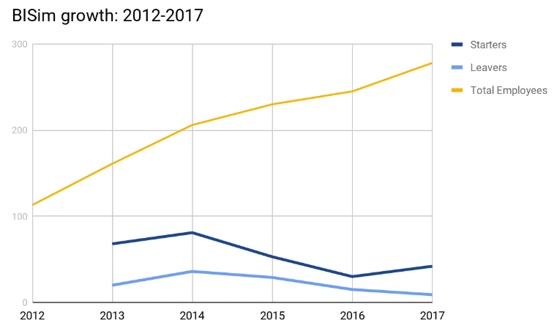
We’ve been there and escaped
2013
15% employee turnover
Constant crunch
200% over-budget
Unpredictable
2018
3% turnover
Zero crunch
60% less bugs
On-budget
Predictable.
15% turnover
20%
3%

Slide 5
The Goal
Building a product
Building a system that builds products
The organization is the product.

Slide 6
Product development as a system
“Resources”
Leadership
Management
Processes
Org structures
Best practices
Practices
Idea + $
Project
Product
Sales
$$$

Slide 7


Product development as a system

Slide 8

Complexity increases exponentially
2006

Slide 9
Complexity increases exponentially
DLC
2006
2007-08

Slide 10
Complexity increases exponentially
DLC
DLC
DLC
DLC
2006
2007-08
2009-12

Slide 11




Complexity increases exponentially
DLC
DLC
DLC
DLC
DLC
DLC
DLC
DLC
DLC
2006
2007-08
2009-12
2013+

Slide 12

Balance order and chaos in the system
Chaos
Order
Too much
Unpredictability, uncertainty
Low quality; unfinished work
Firefighting, crunch
Right amount
+ Creativity, innovation
+ Freedom
+ Challenge
Right amount
Predictability, stability
Quality, finished work
Work life balance
Too much
- Kills creativity
- Oppressive bureaucracy
- Risk-averse, stagnation

Slide 13
BISim org structure - 2018
Head of Development
Product Lead (me)
Product Staff
Lead Designer
Lead Programmer
Lead Producer
DevOps
x4 Smaller products
(similar structures)
Art / Models
Etc
Release QA
Outsource Lead
UX Design
3x Feature Teams
1x Team Lead
2-3x Programmers
1-2x Tech. Designers
2x Testers
Core Engine Team
1x Team Lead
3x Programmers
1x Tester
Central resources (~30 people)
Outsource Teams
(as needed)
VBS3 product group (30-40 people)

Slide 14
BISim org structure - 2018
Head of Development
Product Lead (me)
Product Staff
Lead Designer
Lead Programmer
Lead Producer
DevOps
x4 Smaller products
(similar structures)
Art / Models
Etc
Release QA
Outsource Lead
UX Design
3x Feature Teams
1x Team Lead
2-3x Programmers
1-2x Tech. Designers
2x Testers
Core Engine Team
1x Team Lead
3x Programmers
1x Tester
Central resources (~30 people)
Outsource Teams
(as needed)
VBS3 product group (30-40 people)

Slide 15
BISim org structure - 2018
Head of Development
Product Lead (me)
Product Staff
Lead Designer
Lead Programmer
Lead Producer
DevOps
x4 Smaller products
(similar structures)
Art / Models
Etc
Release QA
Outsource Lead
UX Design
3x Feature Teams
1x Team Lead
2-3x Programmers
1-2x Tech. Designers
2x Testers
Core Engine Team
1x Team Lead
3x Programmers
1x Tester
Central resources (~30 people)
Outsource Teams
(as needed)
VBS3 product group (30-40 people)

Slide 16
Small teams: the basic building block
Small, cross-functional
Stable, dedicated membership
Agile, highly independent
Benefits
Highest human performance
Less waste, faster delivery
Scalable, limits complexity
Feature Teams
1x Team Lead
2-3x Programmers
1-2x Tech. Designers
2x Testers

Slide 17
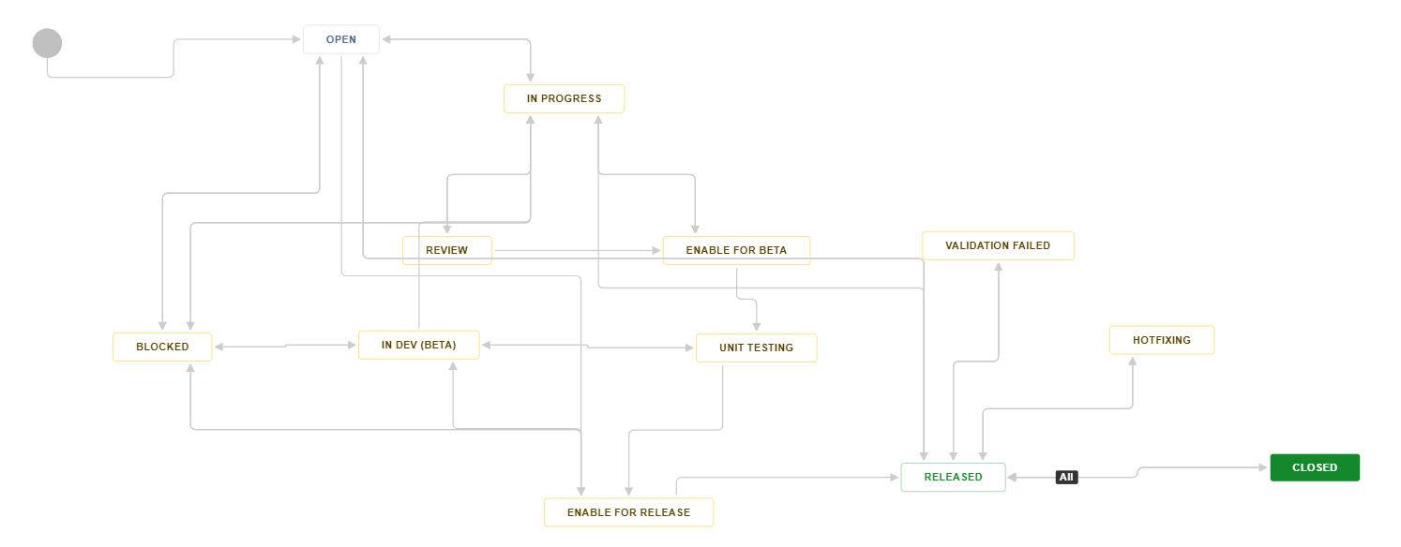
Small teams: the basic building block
2013: “One size must fit all” workflow - many handoffs

Slide 18
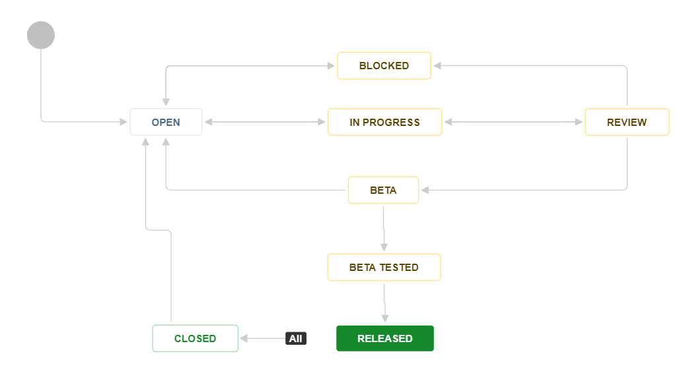
Small teams: the basic building block
2018: Flexible, per-team workflow - no handoffs

Slide 19
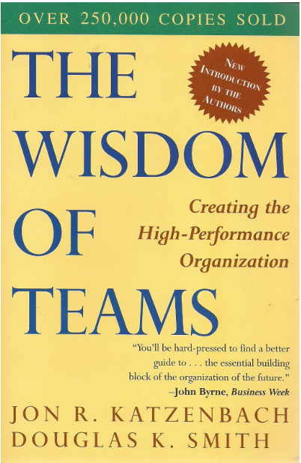
Small teams: the basic building block

Slide 20
BISim org structure - 2018
Head of Development
Product Lead (me)
Product Staff
Lead Designer
Lead Programmer
Lead Producer
DevOps
x4 Smaller products
(similar structures)
Art / Models
Etc
Release QA
Outsource Lead
UX Design
3x Feature Teams
1x Team Lead
2-3x Programmers
1-2x Tech. Designers
2x Testers
Core Engine Team
1x Team Lead
3x Programmers
1x Tester
Central resources (~30 people)
Outsource Teams
(as needed)
VBS3 product group (30-40 people)

Slide 21

Team leads: people leaders, not technical leaders
Biggest factor in success or failure
Technical vs people leaders
Make sure leadership is being provided -- don’t have to provide yourself
Basic management tasks:
  Grow the people: 1 on 1’s, coaching / mentoring
  Grow the team: standups, team meetings
  Manage the work: delegate, monitor progress
  Business communication: up, down, sideways
  Take responsibility for everything
  Thinking long-term
  Hiring (and firing): most important job

Slide 22
You’re doing it wrong if you are...
Doing something that could be delegated
Wasting company money by working directly on the product
Firefighting
Spending too much time disagreeing and being negative
  Action > inaction
  Disagree then commit to action!

Slide 23
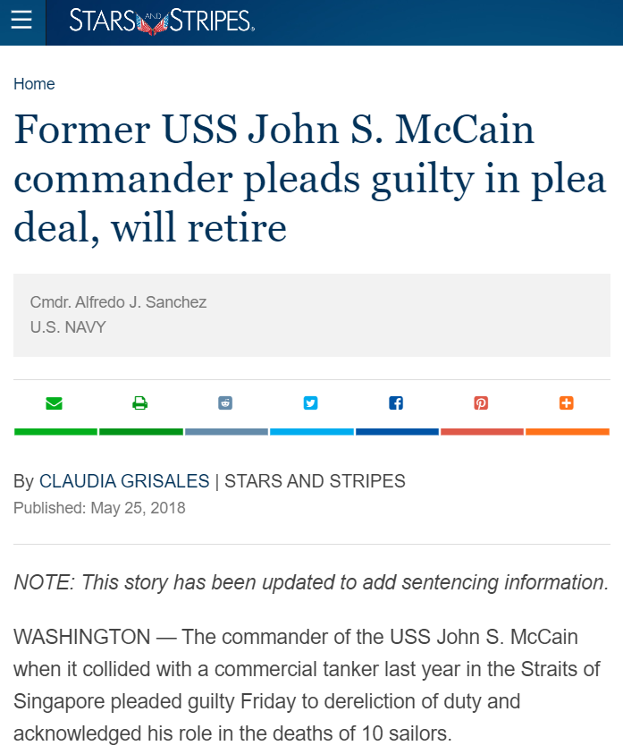
A note about non-traditional structures
Some approaches divide management. Eg
  Scrum (PO vs SM)
  Matrixed organizations (PM vs team lead)
  Producers (depending on implementation)
Make sure one person is ultimately responsible for final work product
https://www.stripes.com/former-uss-john-s-mccain-commander-pleads-guilty-in-plea-deal-will-retire-1.529163

Slide 24


Further reading

Slide 25
BISim org structure - 2018
Head of Development
Product Lead (me)
Product Staff
Lead Designer
Lead Programmer
Lead Producer
DevOps
x4 Smaller products
(similar structures)
Art / Models
Etc
Release QA
Outsource Lead
UX Design
3x Feature Teams
1x Team Lead
2-3x Programmers
1-2x Tech. Designers
2x Testers
Core Engine Team
1x Team Lead
3x Programmers
1x Tester
Central resources (~30 people)
Outsource Teams
(as needed)
VBS3 product group (30-40 people)

Slide 26
Staff vs line: the secret weapon
Great for leveraging senior contributors w/o converting to people-management roles
Line: directly works on shipping product
Staff: supports team leads w/specialized advice and work
Staff has limited direct authority: tension will exist b/w staff and line
Examples: architect, lead designer, marketing, scheduling
Staff roles
Line roles
Product
Product
Product

Slide 27
BISim org structure - 2018
Head of Development
Product Lead (me)
Product Staff
Lead Designer
Lead Programmer
Lead Producer
DevOps
x4 Smaller products
(similar structures)
Art / Models
Etc
Release QA
Outsource Lead
UX Design
3x Feature Teams
1x Team Lead
2-3x Programmers
1-2x Tech. Designers
2x Testers
Core Engine Team
1x Team Lead
3x Programmers
1x Tester
Central resources (~30 people)
Outsource Teams
(as needed)
VBS3 product group (30-40 people)

Slide 28
Middle management: learning to love it
Same basic management tasks still apply
Extra difficulty: everyone has 2 teams
  Staff vs line
  Team-level vs organization-level concerns
  Don’t jump levels in the chain of command!
Don’t just “trust” people - trust the evidence they provide
  You don’t get what you expect, you get what you inspect

Slide 29
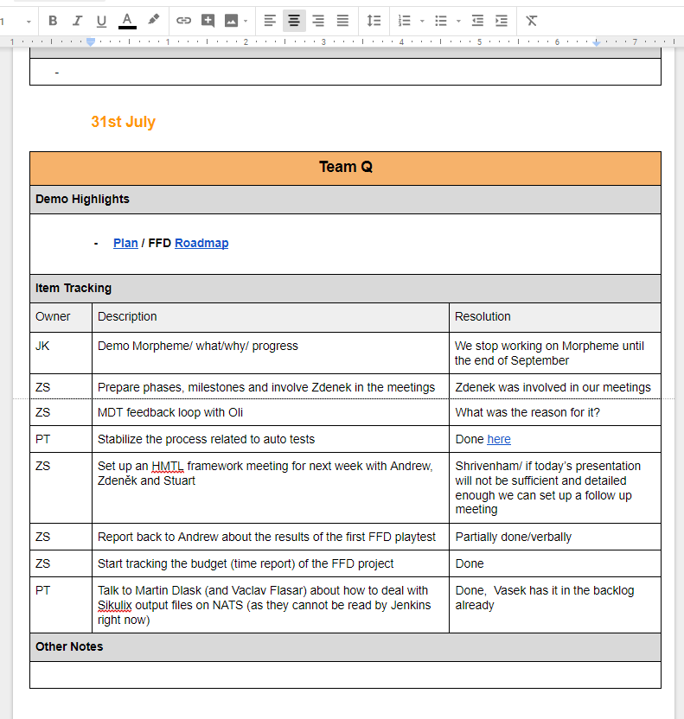
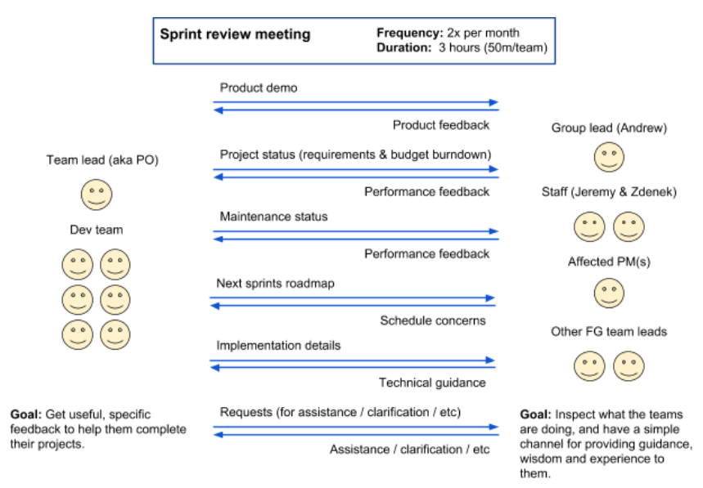
Sprint review - inspecting product and project
Separate executive review meeting used to demo to busier stakeholders!

Slide 30
BISim org structure - 2018
Head of Development
Product Lead (me)
Product Staff
Lead Designer
Lead Programmer
Lead Producer
DevOps
x4 Smaller products
(similar structures)
Art / Models
Etc
Release QA
Outsource Lead
UX Design
3x Feature Teams
1x Team Lead
2-3x Programmers
1-2x Tech. Designers
2x Testers
Core Engine Team
1x Team Lead
3x Programmers
1x Tester
Central resources (~30 people)
Outsource Teams
(as needed)
VBS3 product group (30-40 people)

Slide 31
Top management: a team effort
No plan = chaos for lower levels
  Too detailed plan = illusion of control
  Rely on lower level leaders for details
Must involve other business functions
  CEO / strategy, sales / marketing, finance, support, etc
Example: quarterly resource forecasting meeting
  Forecast sales demand
  Check resource supply
  Take corrective action (hire, shift resources, kill projects, layoffs, etc)

Slide 32
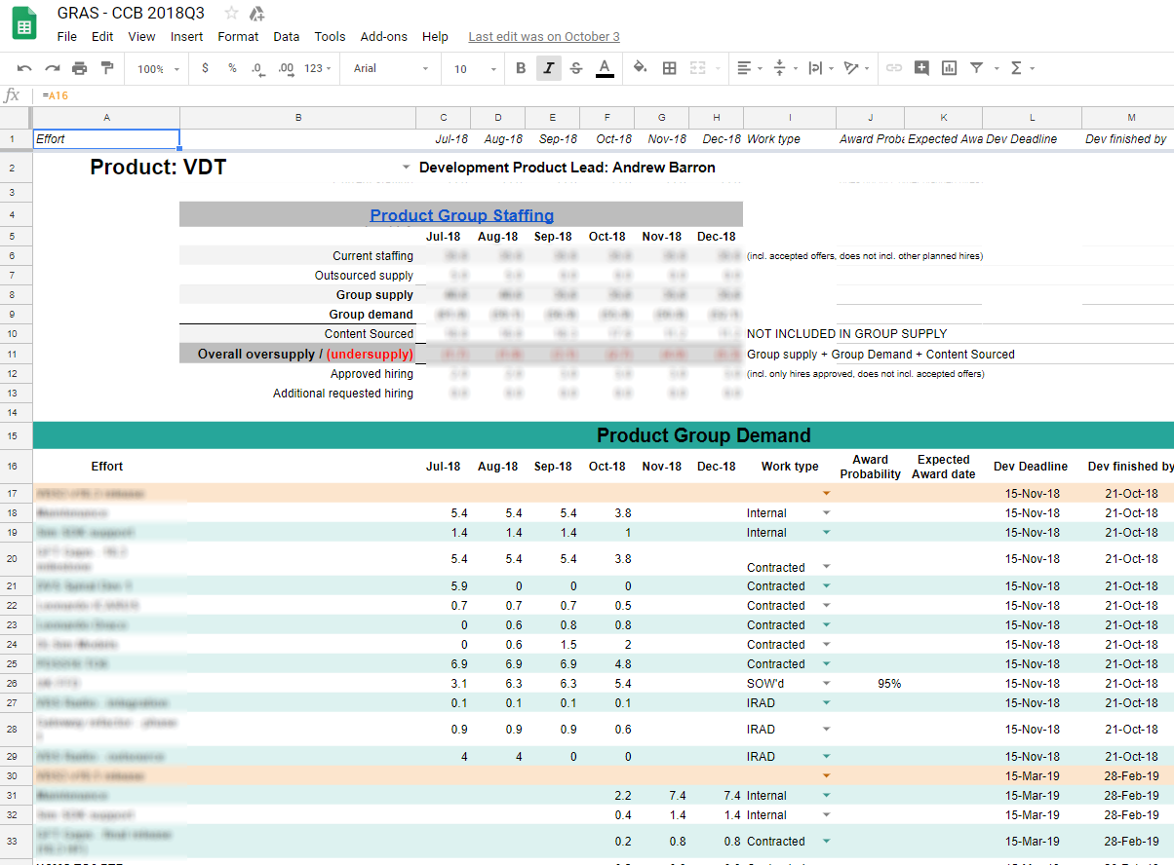
Global resource allocation sheet
(150+ developers)

Slide 33
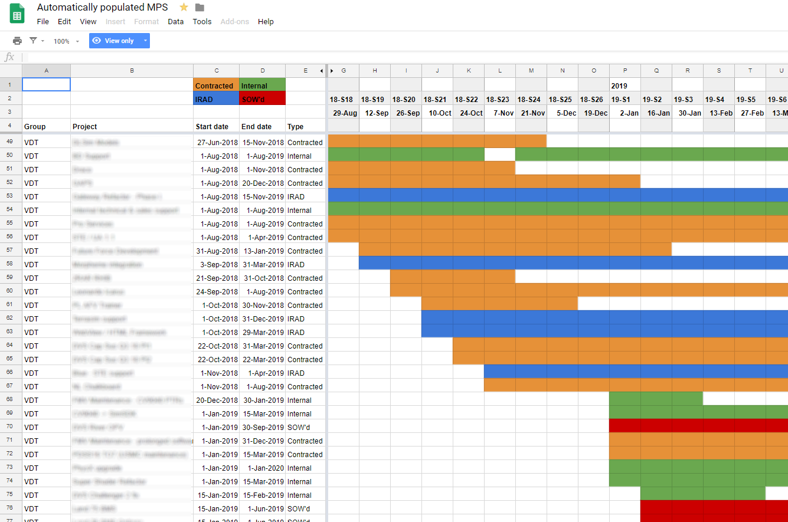
Master production schedule
(80+ projects)

Slide 34
Summary: key lessons learned
The org system is the product - balance order and chaos
Small, cross-functional teams are the basic building block
People managers should lead people (not technical managers)
Staff functions are perfect for senior non-managers
Middle management gets what it inspects (not what it expects)
Top management is a team effort

Slide 35


Thank you! Questions?
Slides: tinyurl.com/ABGameOn2018
Contact:
Andrew Barron
www.andrewbarron.net
linkedin.com/in/andrew-w-barron
info@andrewbarron.net
andrew.barron@bisimulations.com
Recommended reading:
The Goal - Eliyahu Goldratt
The Phoenix Project - Gene Kim, Kevin Behr, George Spafford
The Wisdom of Teams - Jon Katzenbach, Douglas Smith
The Three Levels of Leadership - James Scouller
The Effective Manager - Mark Horstman
Manager Tools Podcast - www.manager-tools.com
Good to Great - Jim Collins
Work with me in Prague!
bisimulations.com/company/careers

